Slide 1
FLIGHT PRICE PREDICTION PROJECT PRESENTATION
Submitted by:
Chris Chhotai (Data Science Intern at Flip Robo Technologies)

Slide 2

INTRODUCTION
Business Requirement

Slide 3
PROBLEM STATEMENT
The airline industry is considered as one of the most sophisticated industry in using complex pricing strategies. Nowadays, ticket prices can vary dynamically and significantly for the same flight, even for nearby seats. Anyone who has booked a flight ticket knows how unexpectedly the prices vary. The cheapest available ticket on a given flight gets more and less expensive over time. This usually happens as an attempt to maximize revenue based on
1. Time of purchase patterns (making sure last-minute purchases are expensive)
2. Keeping the flight as full as they want it (raising prices on a flight which is filling up in order to reduce sales and hold back inventory for those expensive last-minute expensive purchases)

Slide 4

MODEL BUILDING STEPS
1. Data Cleaning
2. Exploratory Data Analysis
3. Data Pre-processing
4. Model Building
5. Model Evaluation
6. Selecting the best model

Slide 5
DATA SCIENCE LIFE CYCLE
Data Cleaning
Import the collected data from web scraping
Exploratory Data Analysis
Check through all the dataset information like datatype, missing value, duplicate value etc.
Visualization and Data Preprocessing
Use various visualization methods to check the data distribution identify presence of outliers and skewness
Clean and format the records as per usage by using various imputation techniques
Analyze each and every data record to ensure we have usable information
Perform encoding and scaling methods

Slide 6
DATA SCIENCE LIFE CYCLE
Model Building
Create appropriate Regression Machine Learning model function
Model Evaluation
Usage of evaluation metrics to check the accuracy of the models over trained and test data inputs
Hyperparameter Tuning Best Model
Choosing the appropriate Regression Machine Learning model to check various parameter permutation and combinations
Need to ensure that whenever the regression function is called it is able to process all the necessary parameters
Ensure the cross-validation techniques helps in reducing over fitting and under fitting data
Using Grid Search CV to obtain the best parameters that can be plugged into the selected model

Slide 7
DATA PREPROCESSING
Importing the necessary dependencies and libraries.
Reading the CSV file and converted into data frame.
Checking the data dimensions for the original dataset.
Looking for null values and accordingly renaming the values.
Checking the summary of the dataset.
Checking unique values.
Checking all the categorical columns in the dataset.
Ensuring that the values are good to use and discarding junk data.

Slide 8
DATA PREPROCESSING
Visualizing with the use of pandas profiling feature.
Visualizing each features using matplotlib and seaborn.
Performing encoding using the ordinal encoder on categorical features.
Checking for co-relation/multi-collinearity in a heatmap.
Checking for Outliers/Skewness using boxen plot and distribution plot.
Checking for the final dimension of dataset to confirm the input details.
Creating train test split and the best random state found in the range 1-1000.
Looking at the importance of feature details to analyse further.

Slide 9
TECHNOLOGY USED
Hardware technology being used.
RAM : 16 GB
CPU : 11th Gen Intel(R) Core(TM) i7-11390H @ 3.40GHz 2.92 GHz
Software technology being used.
Programming language : Python
Distribution : Anaconda Navigator
Browser based language shell : Jupyter Notebook
Libraries/Packages specifically being used.
Pandas, NumPy, matplotlib, seaborn, scikit-learn, pandas-profiling, missingno

Slide 10
EXPLORATORY DATA ANALYSIS (EDA) AND VISUALIZATION
01. Univariate Analysis
02. Multivariate Analysis
03. Correlation of Dataset
The most basic type of data analysis is univariate analysis. Because "uni" implies "one," your data only has one variable..
Multivariate analysis is a collection of statistical approaches for analysing data with several variables.
Correlation is a technique for determining whether or not two quantitative or categorical variables are related.
04. Correlation with Target variable
05. Conclusion
To understand how the data is related, use correlation with the goal variable.
Summary with the conclusion of all the analysis

Slide 11
EXPLORATORY DATA ANALYSIS (EDA)
First, I loaded the complete dataset into our Jupyter Notebook after importing the appropriate libraries and renaming the project file from untitled.
Then I looked at the layout of our data and saw that we have 5,805 rows and 9 different columns.
In our dataset, there are no null or missing values.
Our dataset had 232 duplicate rows/records, however I chose to keep them rather than delete them.
By examining the data types, I discovered that our data set contains columns with just object datatypes, despite the presence of numeric data.
Shape : 5,805 rows and 9 columns
No null values present
232 duplicate rows/records were found
Datatype of only object columns are in dataset

Slide 12
COUNT PLOTS

Slide 13
BAR PLOTS

Slide 14
BAR PLOTS AND SCATTER PLOTS

Slide 15
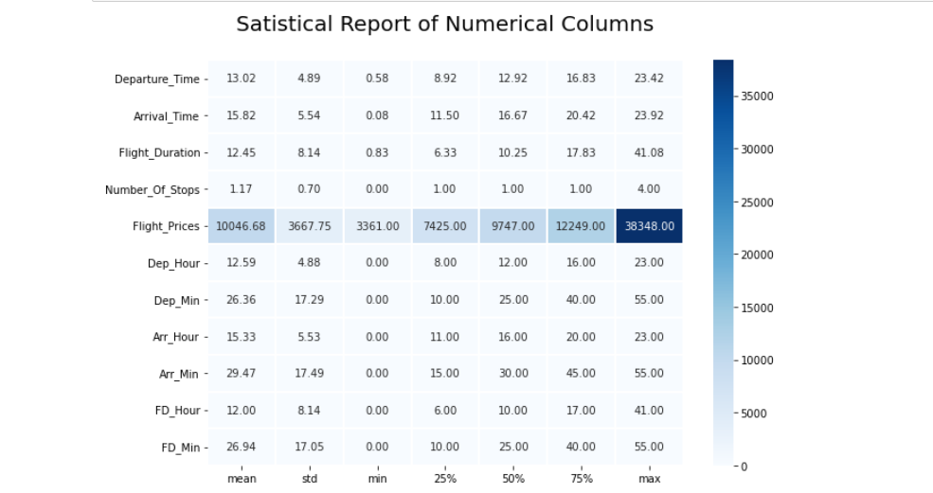
DESCRIPTION OF DATA

Slide 16
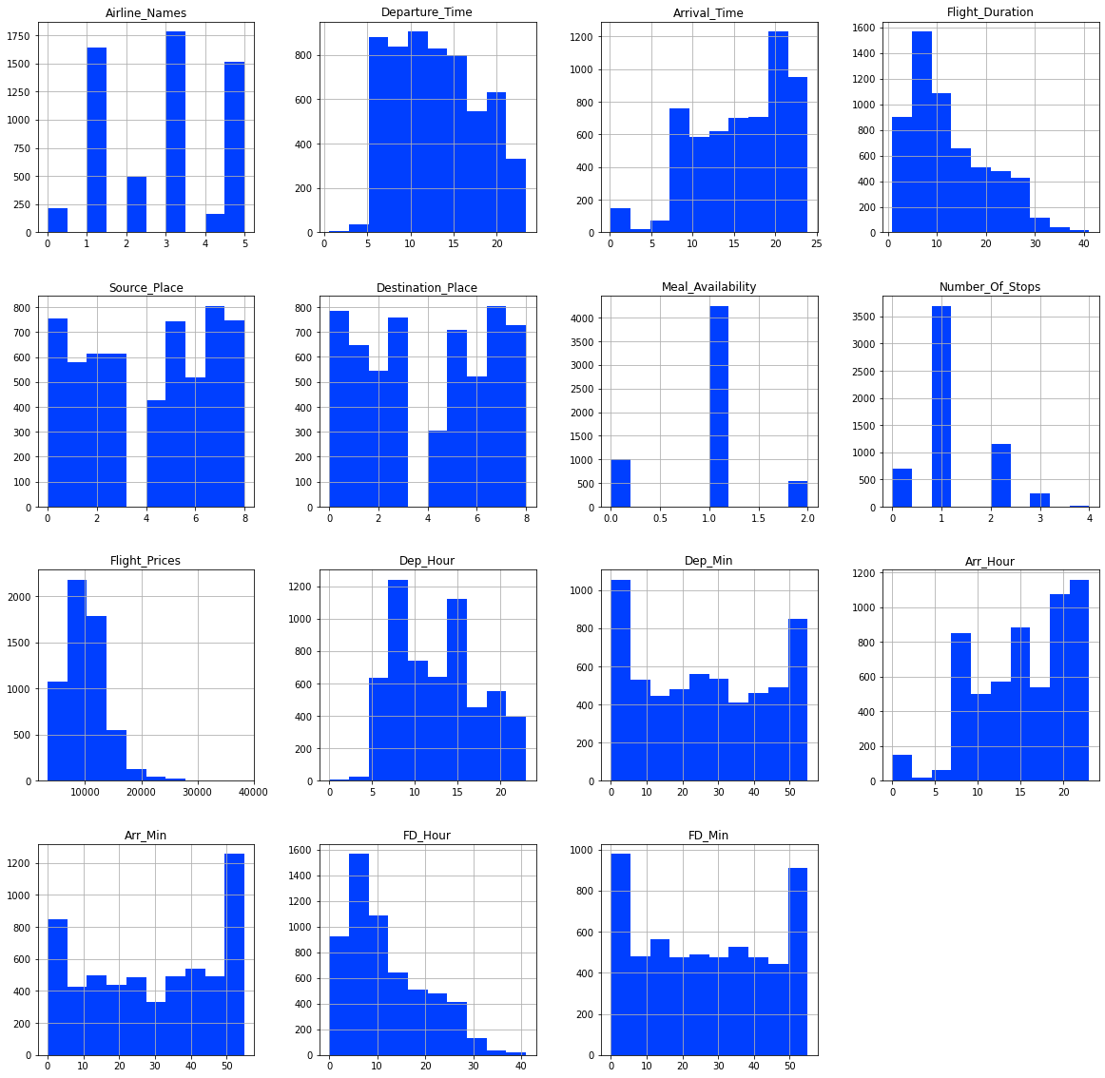
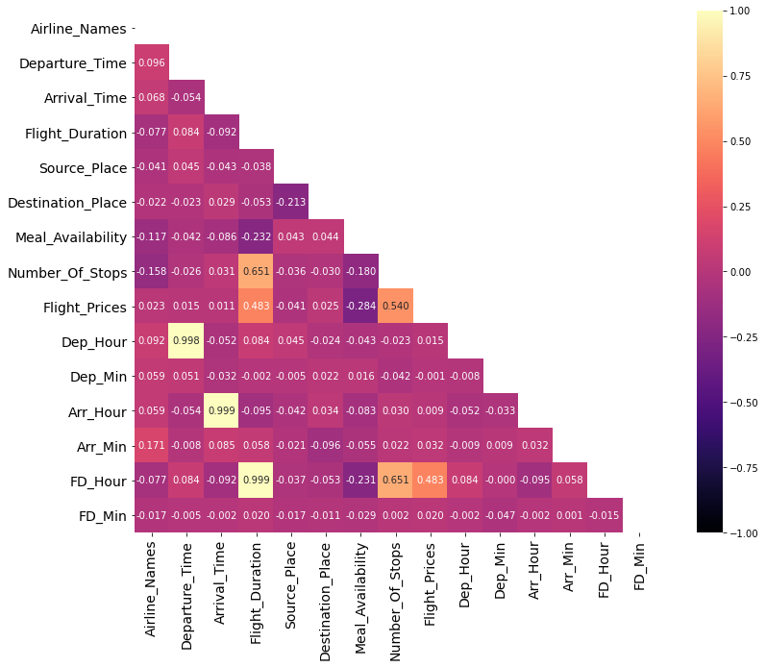
HISTOGRAM AND HEATMAP

Slide 17
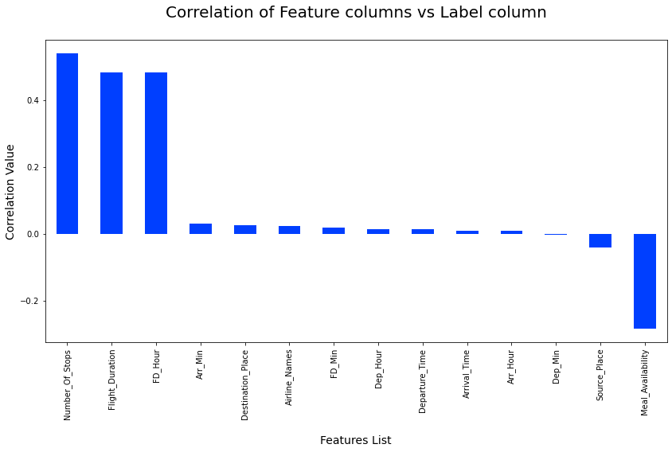
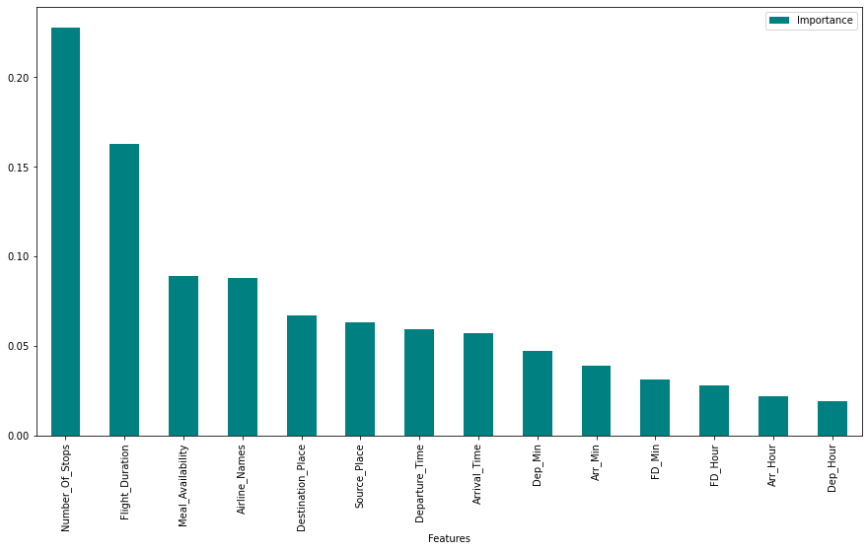
CORRELATION AND IMPORTANCE BAR GRAPHS

Slide 18
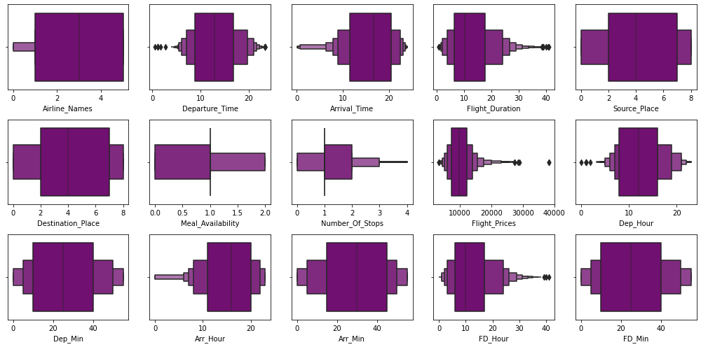
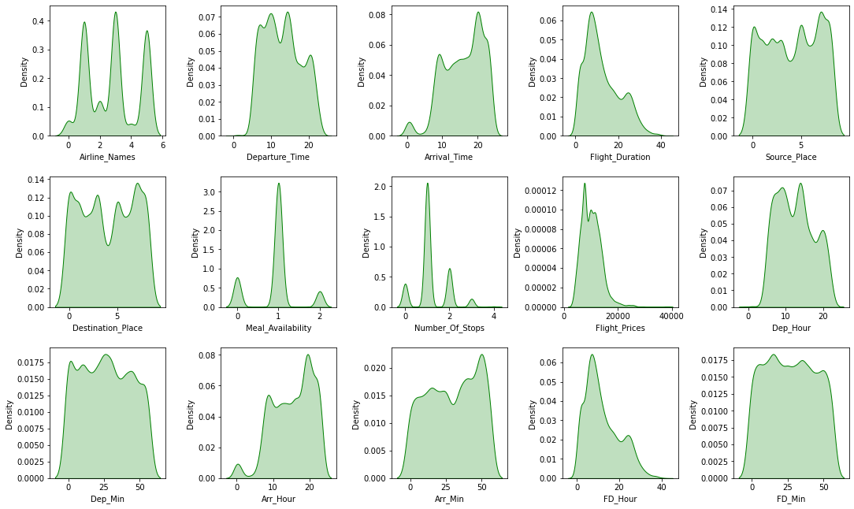
OUTLIERS AND SKEWNESS

Slide 19
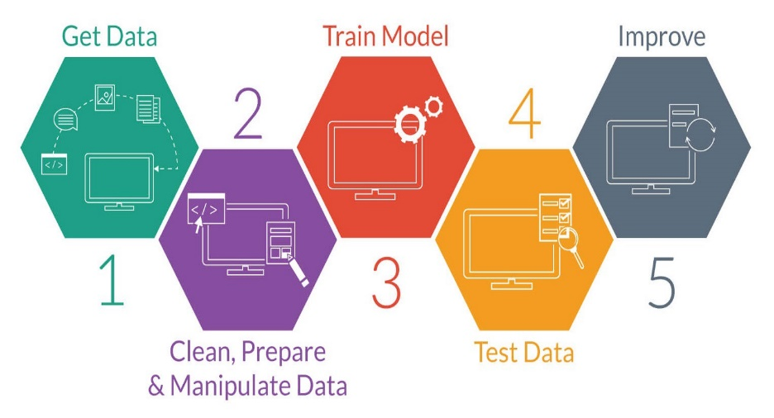
MODEL TRAINING PHASES

Slide 20

REGRESSION MACHINE LEARNING MODEL/S USED
▪ Linear Regression Model
▪ Ridge Regularization Model
▪ Lasso Regularization Model
▪ Support Vector Regression Model
▪ Decision Tree Regression Model
▪ Random Forest Regression Model
▪ K Neighbours Regression Model
▪ Gradient Boosting Regression Model
▪ Ada Boost Regression Model
▪ Extra Trees Regression Model

Slide 21
REGRESSION MODEL FUNCTION WITH EVALUATION METRICS

Slide 22
RESULT OF MULTIPLE REGRESSION MODELS

Slide 23
EVALUATION AND HYPER PARAMETER TUNING
The key metrics used here were:
R2 score
Cross Validation Score
MAE
MSE
RMSE
Using Hyperparameter Tuning, we sought to discover the optimal parameter list to improve our accuracy ratings. We utilised the Grid Search CV method with 5 folds to attain a higher score.

Slide 24
Inference
Concluding the project outcome

Slide 25
KEY FINDINGS AND CONCLUSIONS OF THE STUDY
In this project, we have collected flight information from airline websites for this project. Flight time, number of stops along the way, and meal availability are all factors that influence flight prices.
It may also assist clients in predicting future flight prices and planning their journey appropriately, as it is difficult for airlines to maintain pricing as they fluctuate owing to many factors. As a result, we can address this problem utilizing Machine Learning approaches.
The preceding research will assist our customer in studying the most recent flight price market, and with the model produced, he will be able to readily estimate flight price ranges, as well as understand the factors which are used to determine the price of a fight.

Slide 26
LEARNING OUTCOMES OF THE STUDY IN RESPECT OF DATA SCIENCE
The data visualization section assisted me in understanding the data by providing a graphical depiction of large amounts of data.
It helped me comprehend the importance of features, outliers, and skewness detection, as well as compare independent and dependent features.
Because data cleansing is the most crucial element of model construction, I made sure the data was clean before starting.
I created various regression machine learning models to find the best one, and based on the criteria I used, Extra Trees Regressor Model was the best.
I made sure I got a decent prediction confidence percentage.

Slide 27
LIMITATIONS OF THIS WORK AND SCOPE FOR FUTURE WORK
Some algorithms have issues with overfitting, which could be due to the smaller number of features in our dataset.
The study's limitation is that we collected data in a dynamic changing market; to be more specific, we collected data during the epidemic and recent data, so when the pandemic is over, the market may correct slowly.
As a result, the deciding variables may change dependent on that, and we have shortlisted and collected data from significant cities across India.
If the consumer is from a foreign country, our model may be unable to anticipate the flight's accuracy price.

Slide 28
